Slide 1
DATA SCIENCE PORTFOLIO
Muthia Aisyah Putri
https://github.com/muthiaap

Slide 2
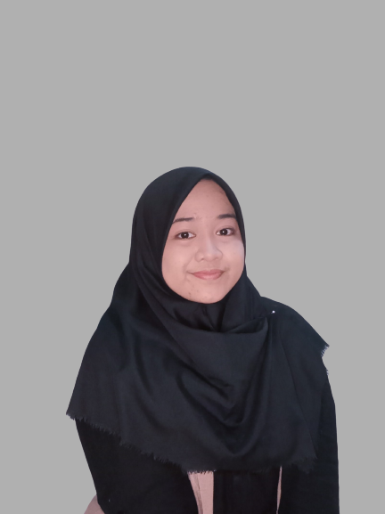
Muthia Aisyah Putri
Completed Bachelor of Mathematics Education from Jakarta State University. Interested in studying mathematics, academics, and data and currently pursuing a lot in the field of data science by attending boot camp and several courses.

Slide 3
EDUCATION
Universitas Negeri Jakarta Mathematics Education
YEAR : 2017 - 2022
GRADE : 3.73/4.00

Slide 4
WORKING EXPERIENCES
2020
2021 - 2022
2022 - PRESENT
SMAN 100 Jakarta
ZENIUS EDUCATION
QUIPPER
Mathematics Teacher
Taught mathematics to 10th graders.
Mathematics Tutor
Taught mathematics to high school students through learning videos and tests as one of the products of Zenius Education.
Mathematics Specialist
Carried out quality control and supervision of learning products produced by Quipper Indonesia, especially in mathematics.

Slide 5
SKILLS AND PROFICIENCY
SQL Database
Math and Statistics
Python Programming Language
Data Visualization
Machine Learning

Slide 6
DATA SCIENCE PROJECT
01
Telco Customer Churn Prediction
02
03
Analyzing Bank Customers on Credit Approval Predictions
Toronto Major Crime Analysis During 2014 - 2022

Slide 7
Telco Customer Churn Prediction
Predict behavior to retain customers. Analyze all relevant customer data and develop focused customer retention programs.

Slide 8
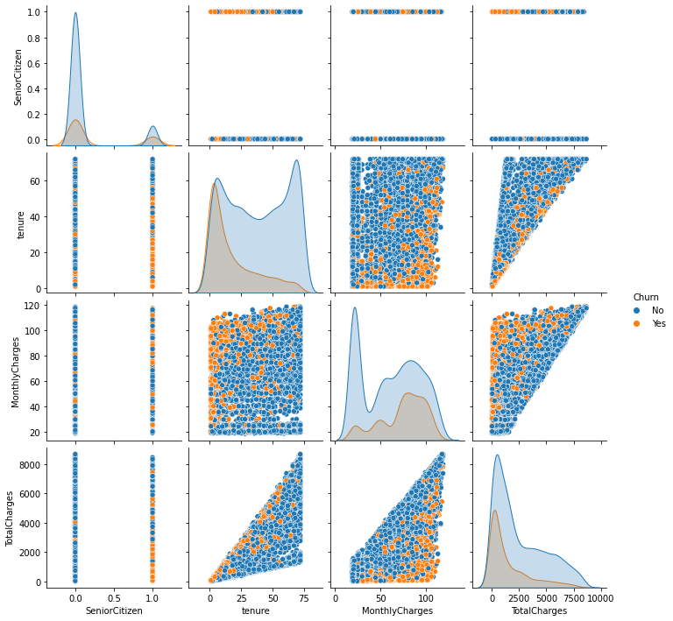
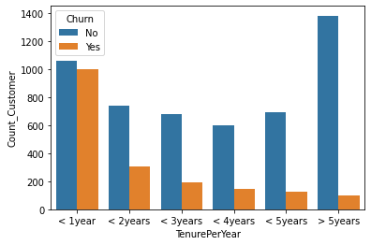
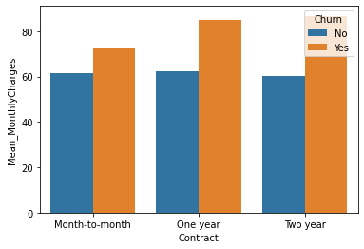

Slide 9
Airline Customer Value Analysis
Segmenting customers at an airline company. Based on the flight activity records of all customers and transactions, customers can be classified to determine the best treatment.

Slide 10
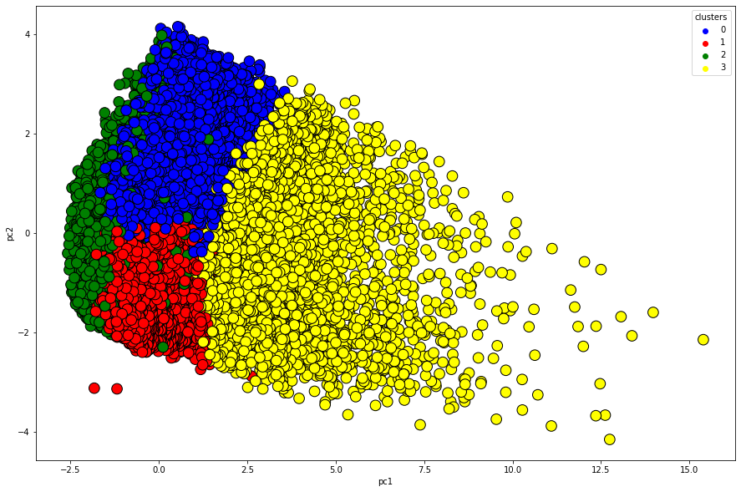
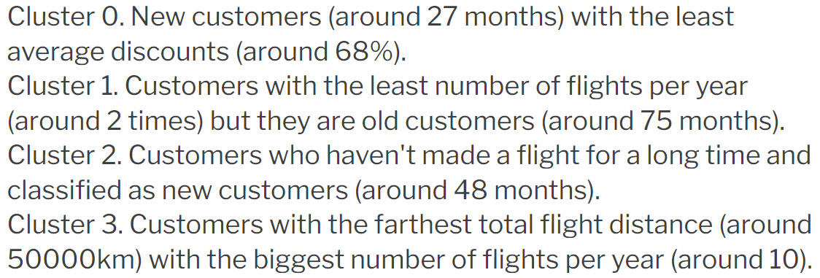
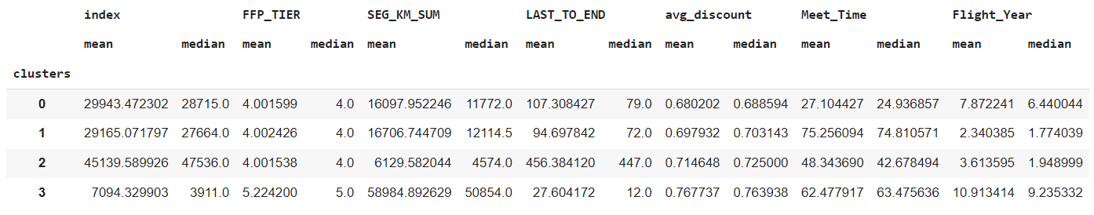

Slide 11
Analyzing Bank Customers on Credit Approval Predictions
Analyzing personal customer information criteria for a bank based on predictions that credit applications will be approved. Some of the most meaningful information can be identified by predicting whether credit applications from customers will be approved.

Slide 12
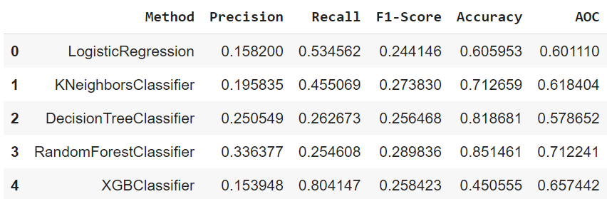
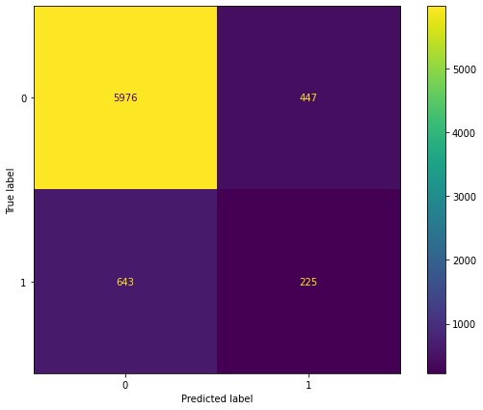
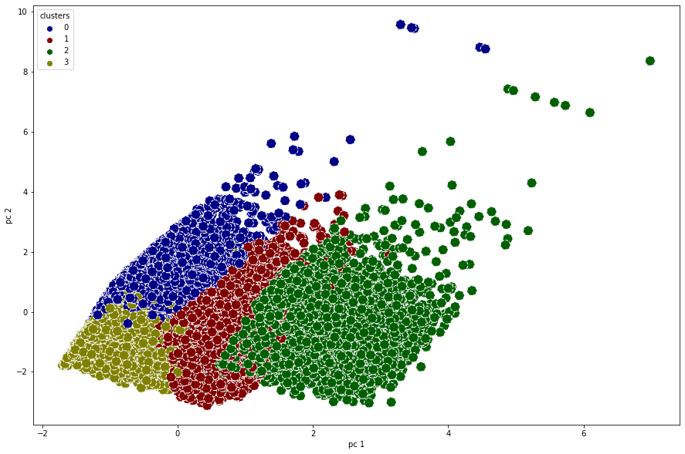
11,8%
88,2%
Predicted to be risk
Predicted not at risk

Slide 13
Toronto Major Crime Analysis During 2014 - 2022
The dataset includes all Major Crime Indicators (MCI) occurrences by reported date and related offenses from 2014 to June 30, 2022. This study aimed to analyze major crime in the neighborhoods in Toronto.

Slide 14
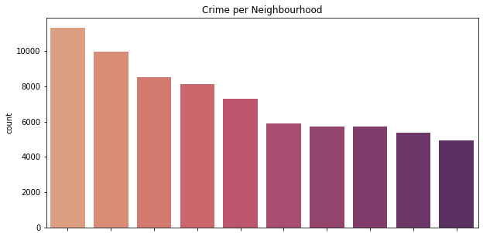
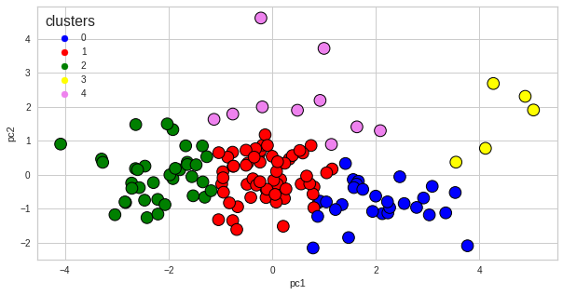
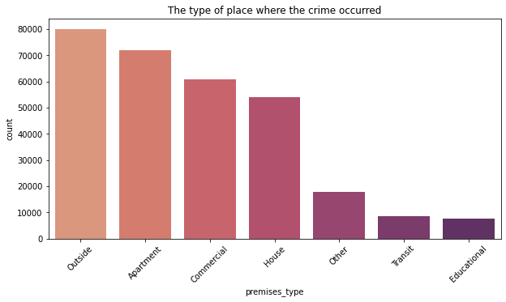
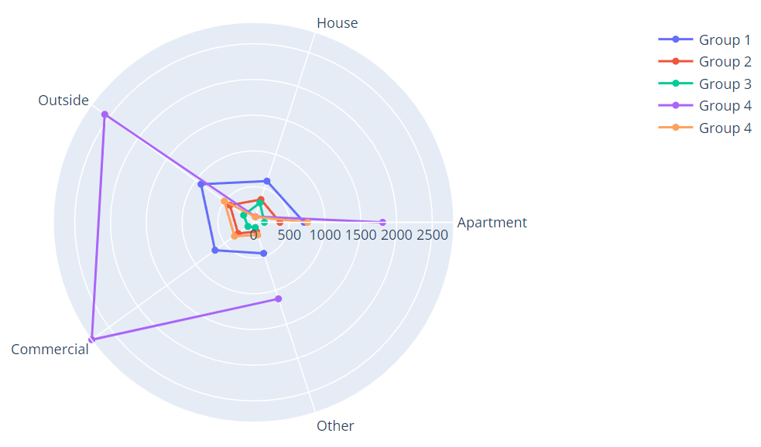

Slide 15



CONTACT ME
EMAIL
muthiaaisyahputri26@gmail.com
PHONE
(+62) 821 1171 5878
LINKEDIN
www.linkedin.com/in/muthiaap/

Slide 16
Toronto Major Crime Analysis During 2014 - 2022
Muthia Aisyah Putri
https://github.com/muthiaap

Slide 17
OUTLINE
01
02
INTRODUCTION
DATA FEATURE AND ANALYSIS
03
04
CONCLUSION
MACHINE LEARNING MODEL

Slide 18
01
INTRODUCTION

Slide 19
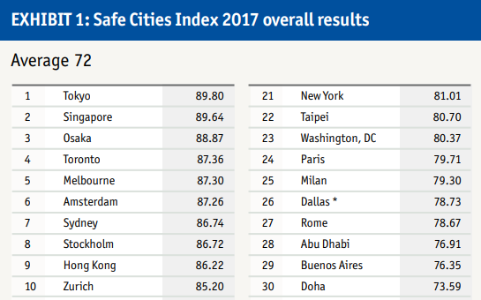
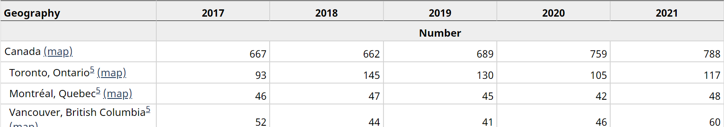
INTRODUCTION
Source: safecities.economist.com
Source: https://www150.statcan.gc.ca/

Slide 20
02
DATA FEATURE AND ANALYSIS

Slide 21
About The Data
29 Column
6 Index and ID Information
9 Location Information
6 Report Time Information
6 Occurrence Time Information
2 Type of Crime Information
301233
Records

Slide 22
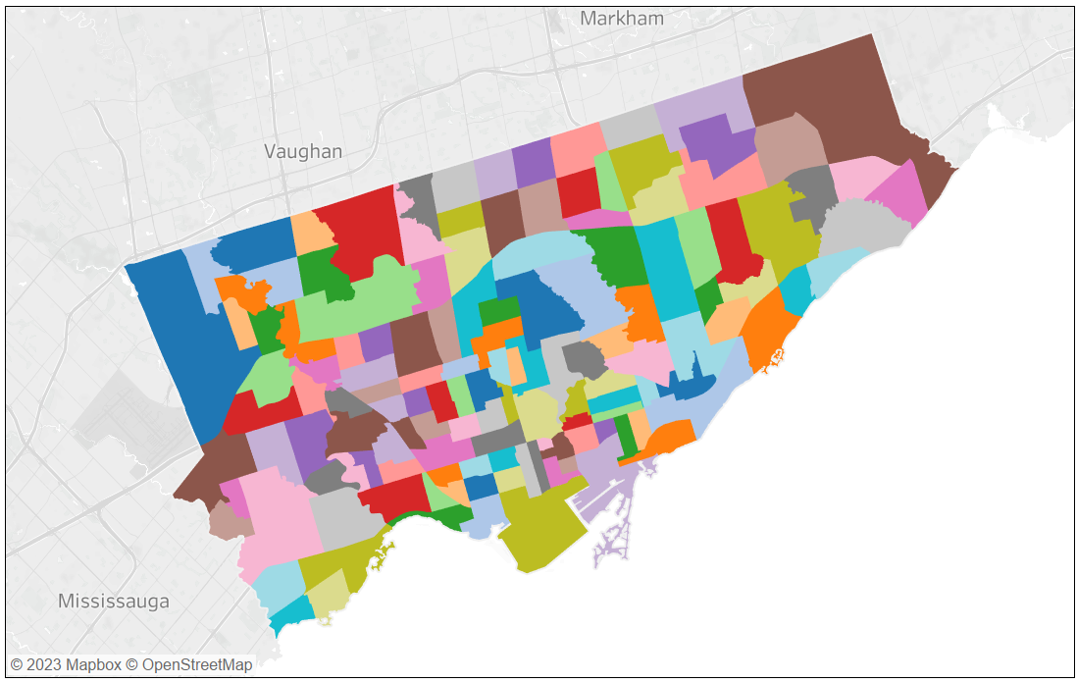
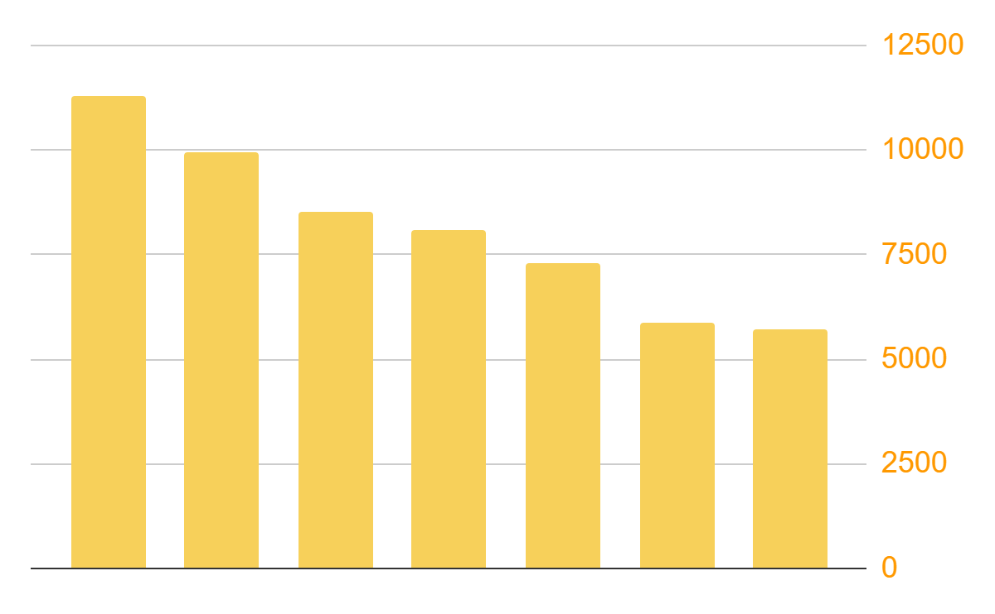
Crime per Neighbourhood
MOST CRIME-RIDDEN NEIGHBOURHOODS
141 Neighbourhood
Waterfront Communities-The Island
Church-Yonge Corridor
Bay Street Corridor
West Humber-Clairville
Moss Park
York University Heights
Downsview-Roding-CFB

Slide 23
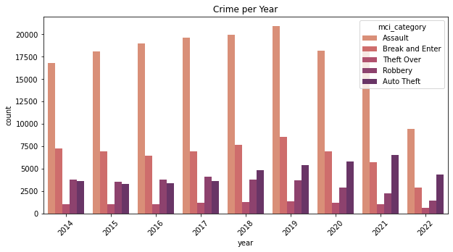
Type of The Crimes per Year
Crimes increased during 2014 – 2019
Since 2019, crimes slightly decrease.
Assault is the most common crime.
Note: Data only shows until June 2022

Slide 24
Location Type of The Crimes
HOUSE
APARTMENT
COMMERCIAL
single house
Apartment (Rooming House, Condo)
Bank, Bar, Gas Station, and other public places
OUTSIDE
TRANSIT
EDUCATIONAL
OTHERS
Public transportation, stations, rail vehicles
During a school or university activity
Open Areas, Parking Lot, Street, Yard, and Shelter
Private Property Structure, Religious Facilities, Nursing Homes, etc

Slide 25
Location Type of The Crimes
The location where most crimes occur is the outside, apartment, commercial, and house.

Slide 26
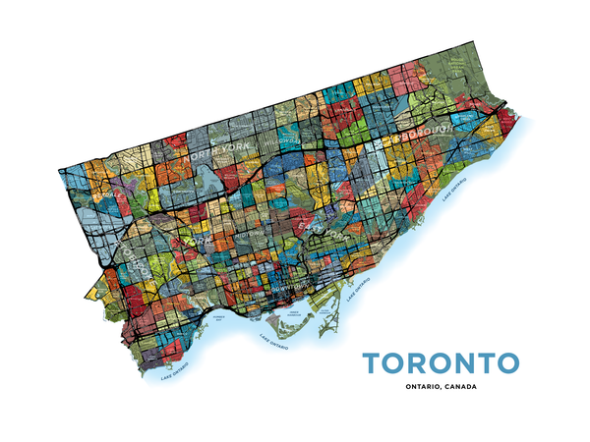
03
MACHINE LEARNING MODEL
TORONTO

Slide 27
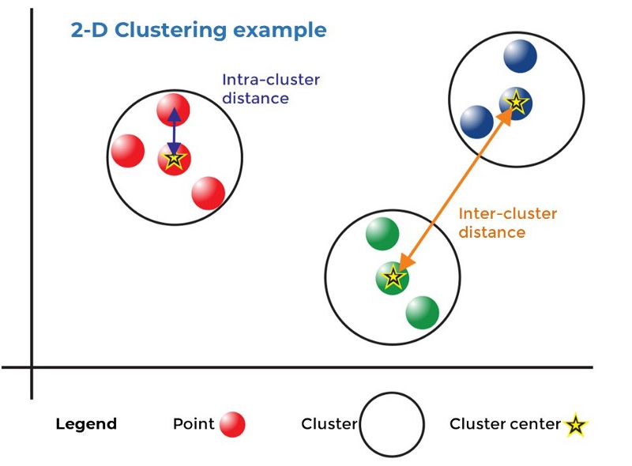
K-Means Clustering
141 Neighbourhood
K Cluster
Based on the location type of the crimes

Slide 28
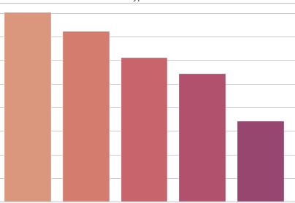
FEATURE SELECTION

Slide 29
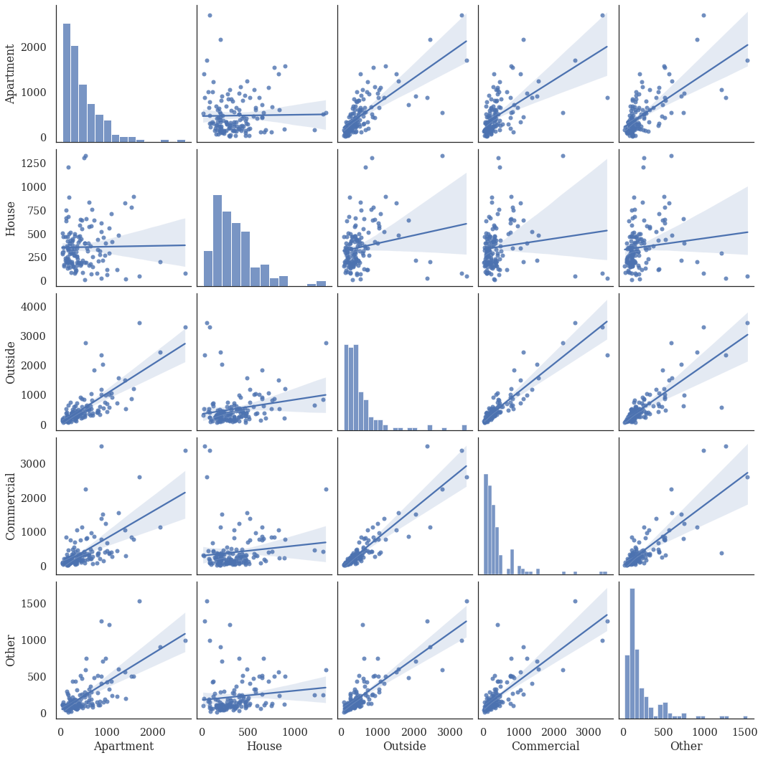
FEATURE ANALYSIS

Slide 30
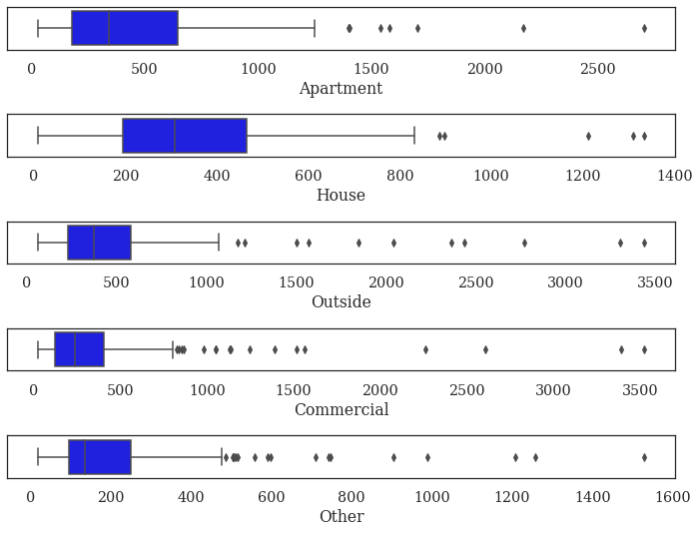
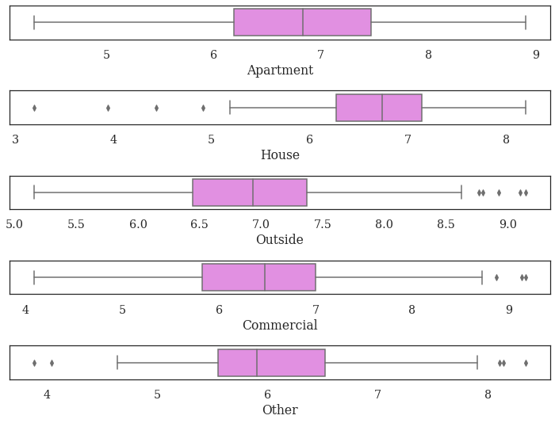
LOG TRANSFORMATION

Slide 31
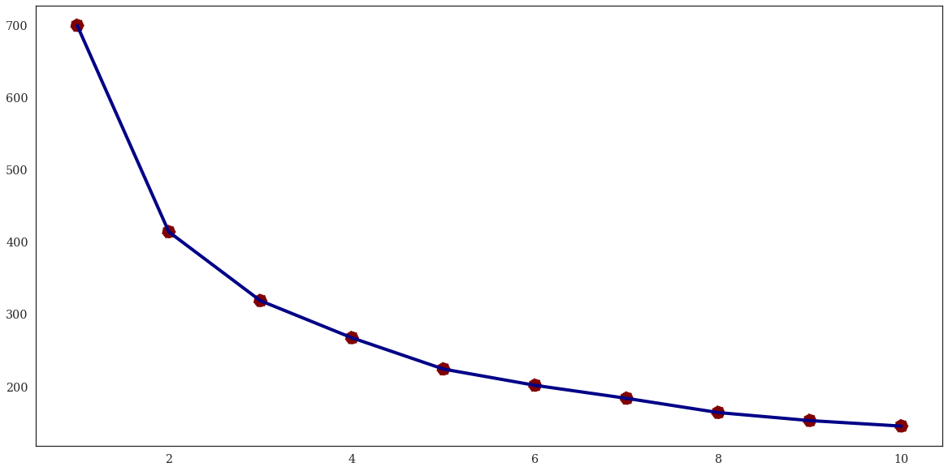
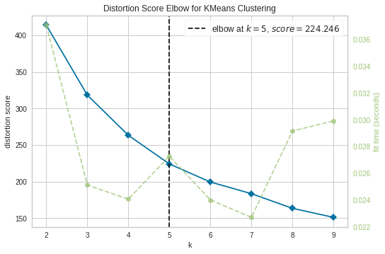
FIND THE BEST K
Will be chosen K = 5

Slide 32
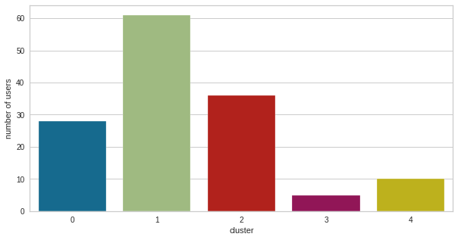
CLUSTER DISTRIBUTION

Slide 33
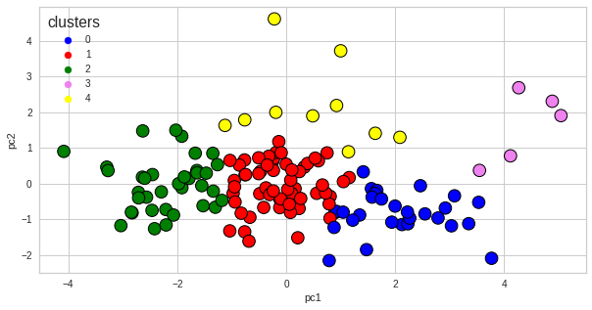
CLUSTER VISUALIZATION

Slide 34
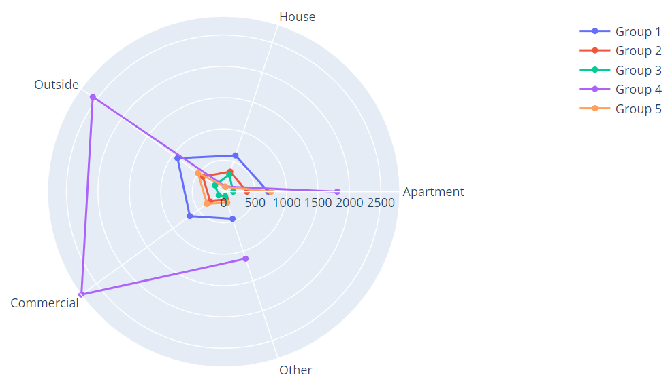
CLUSTER VISUALIZATION

Slide 35
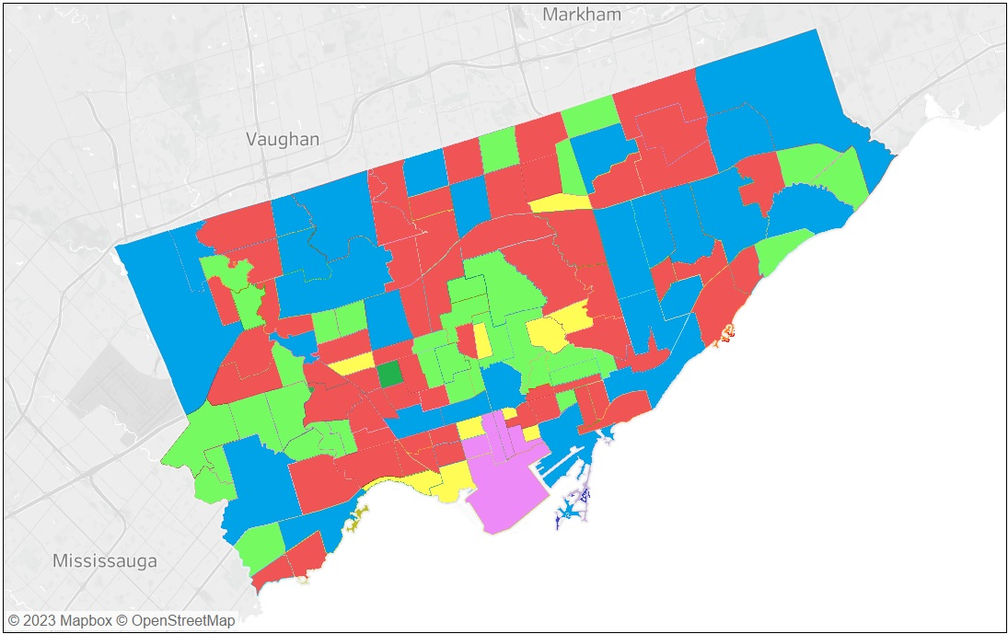
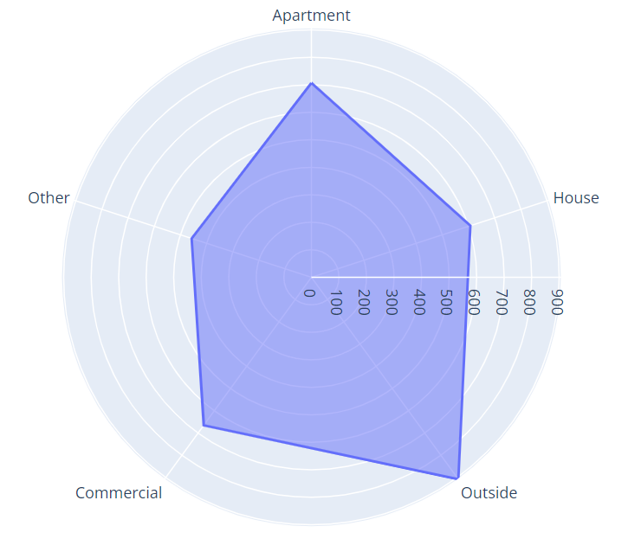
NEIGHBOURHOOD GROUP 1
Blue
Has the second-largest rate of crime.
There should be more attention to guarding so that it will significantly lower the crime rate.
Outside, apartments, and commercials should get more attention.

Slide 36
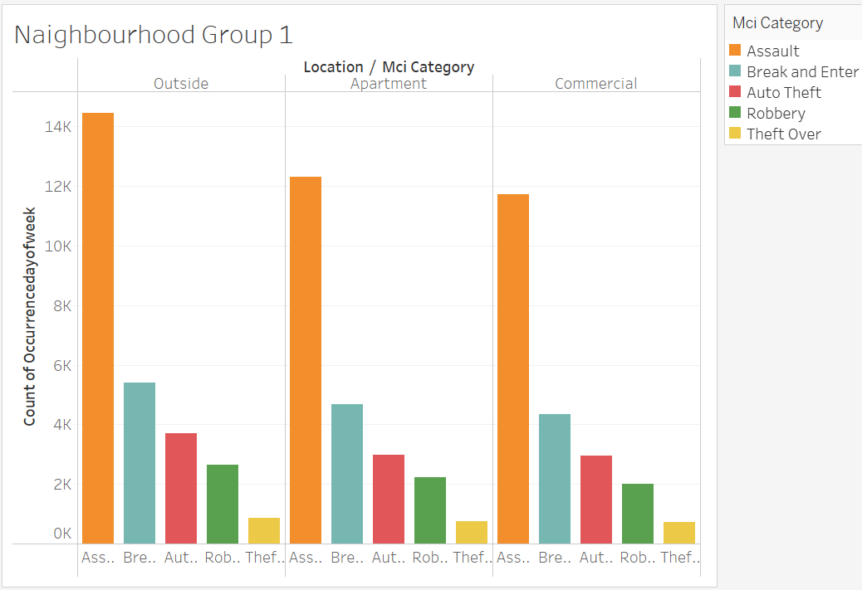
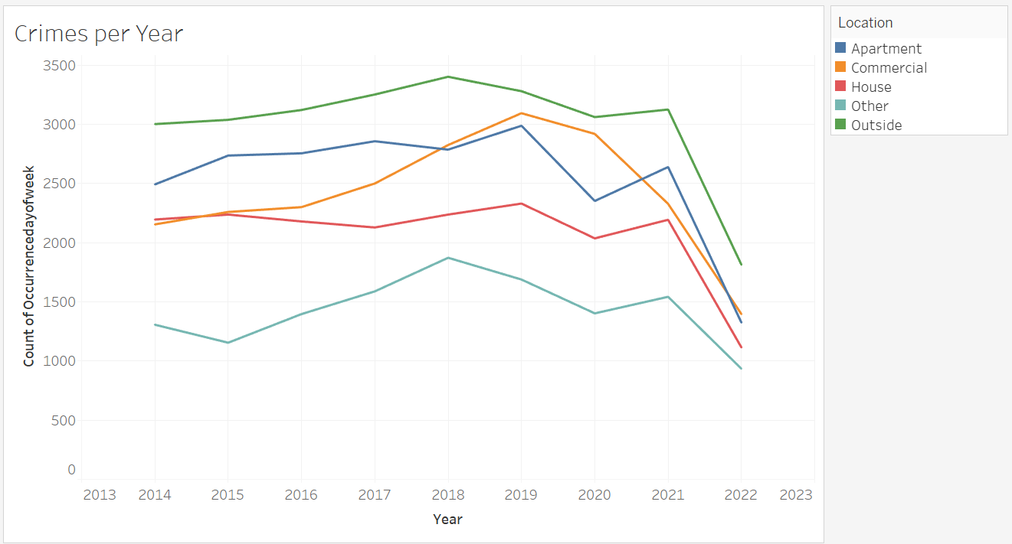

Slide 37
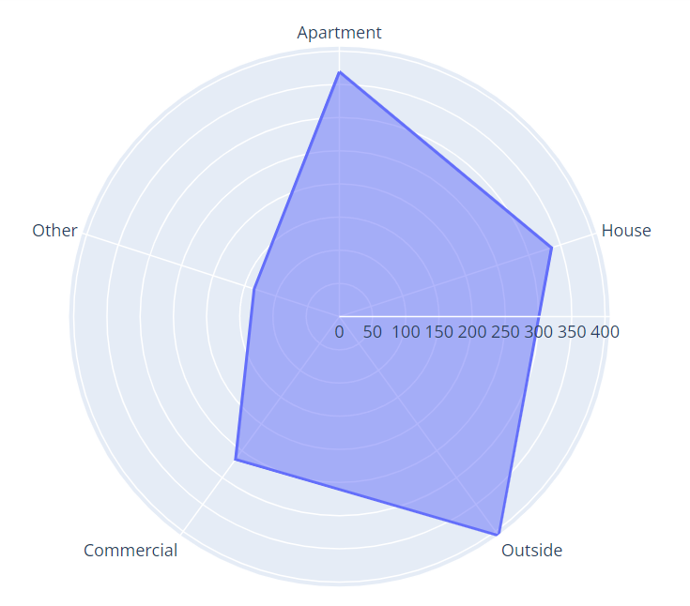
NEIGHBOURHOOD GROUP 2
Red
Has the second-lowest rate of crime.
Outside, apartments, and houses should get more attention.

Slide 38
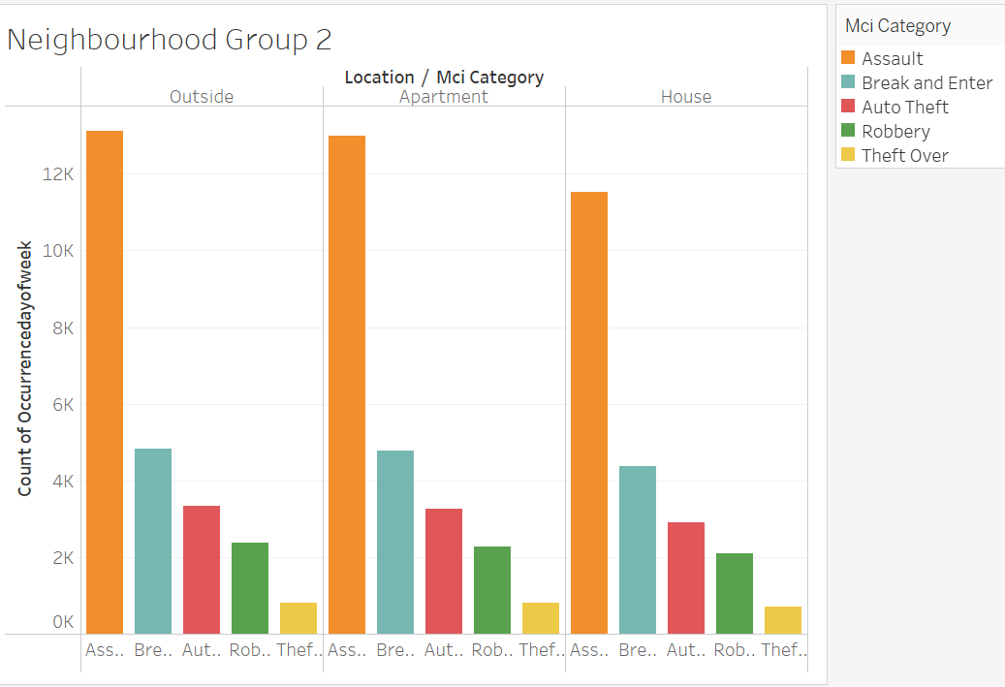
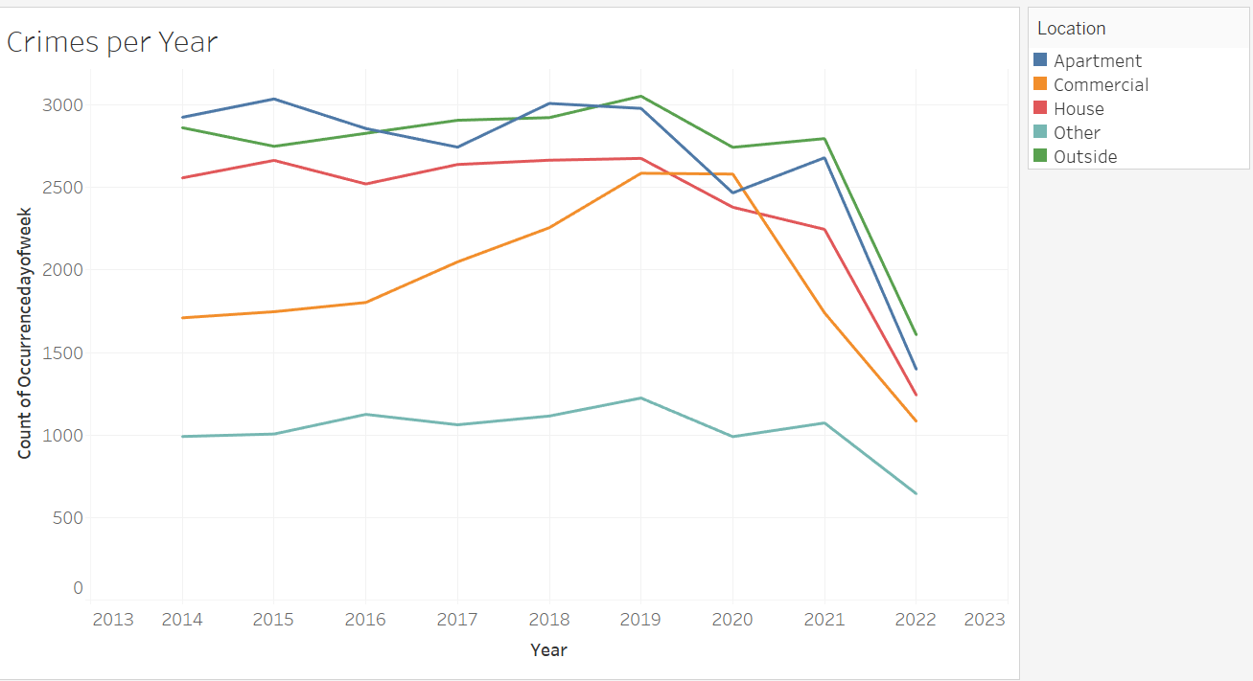

Slide 39
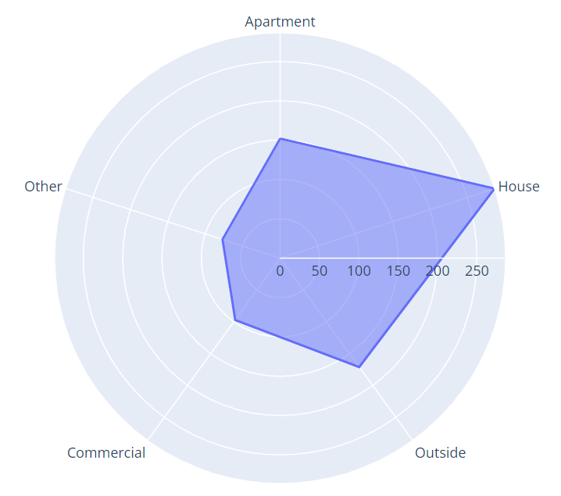
NEIGHBOURHOOD GROUP 3
Green
Has the lowest rate of crime.
Houses, outside, and apartments should get more attention.

Slide 40
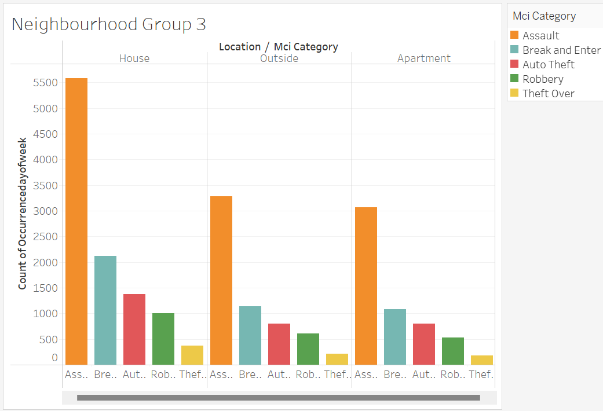
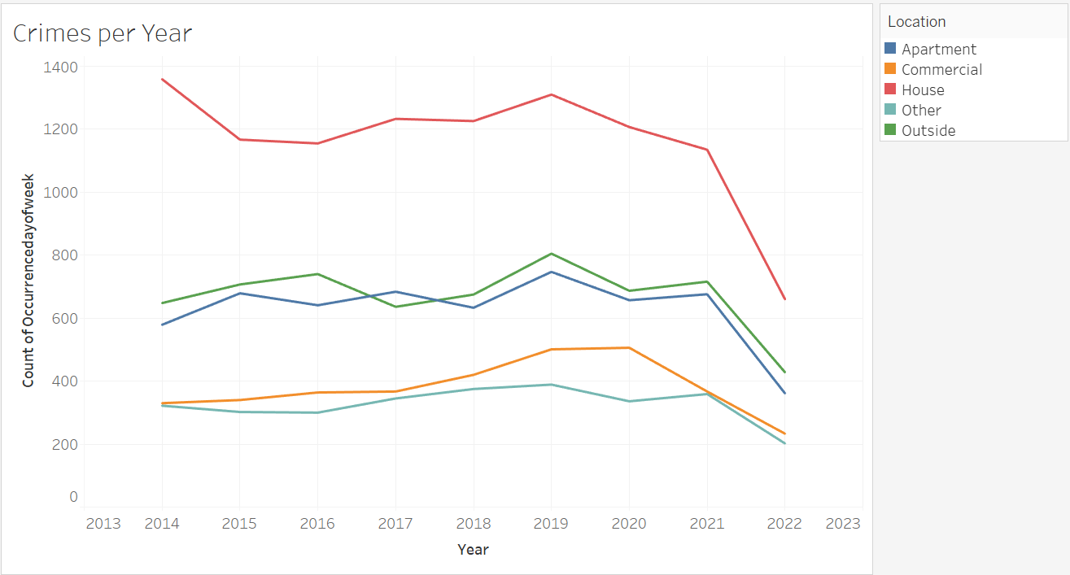

Slide 41
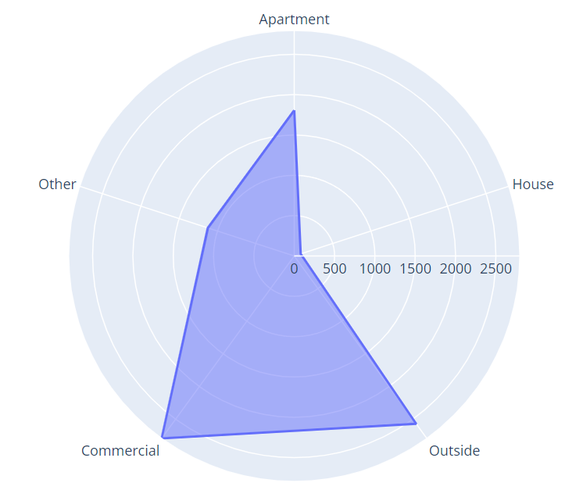
NEIGHBOURHOOD GROUP 4
Violet
Has the largest rate of crime.
There should be more attention to guarding so that it will significantly lower the crime rate.
Commercials, Outside, and Apartments should get more attention.

Slide 42
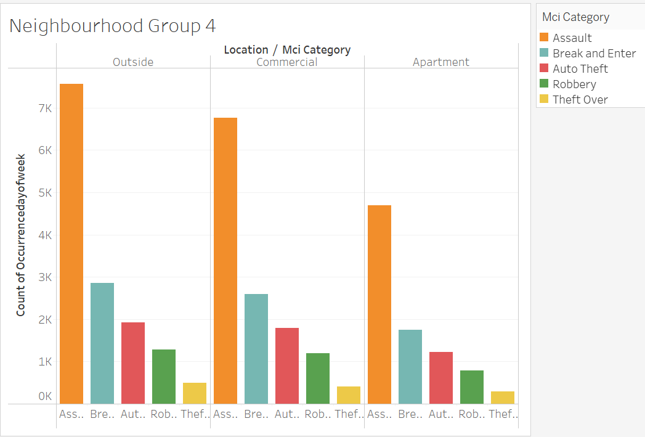
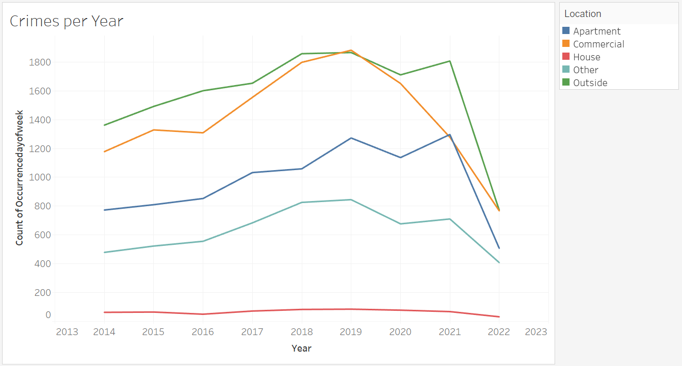

Slide 43
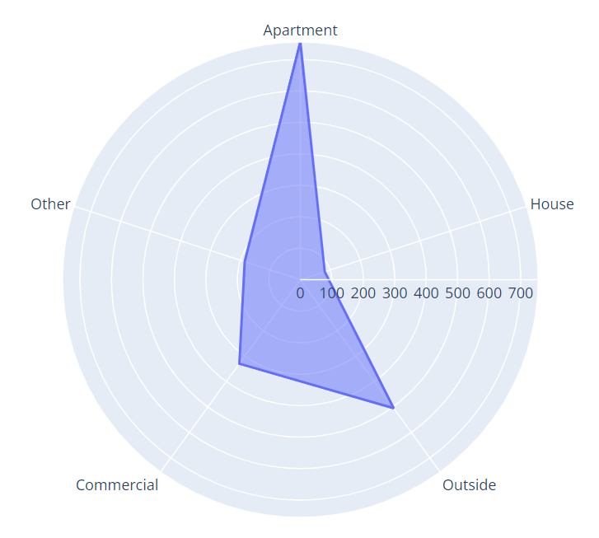
NEIGHBOURHOOD GROUP 5
Yellow
Has the third-largest rate of crime.
There should be more attention to guarding so that it will significantly lower the crime rate.
Apartments, Outside, and Commercials should get more attention.

Slide 44
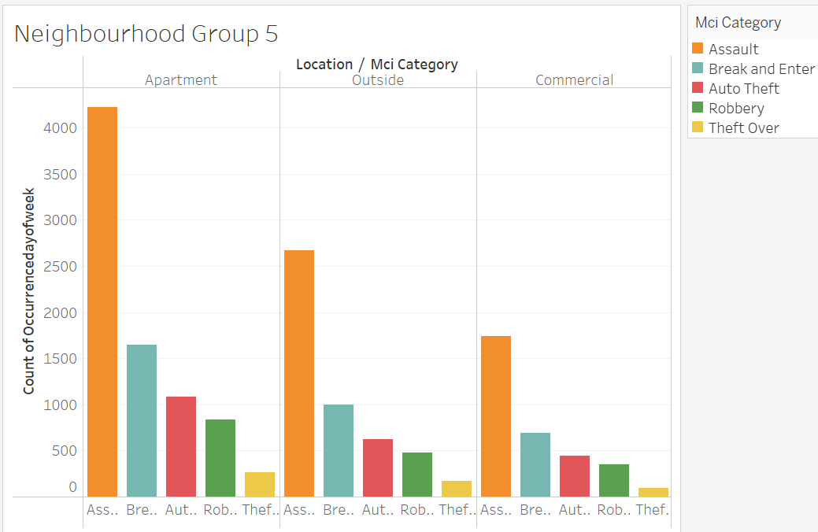
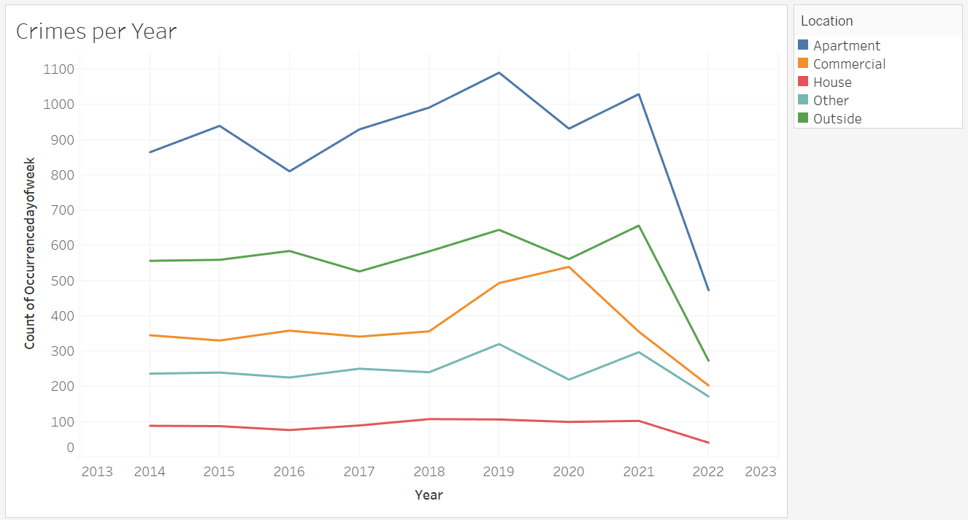

Slide 45
04
CONCLUSION

Slide 46
Group 1
Group 2
Group 3
Group 4
Group 5

Slide 47
NEIGHBOURHOOD ATTENTION
01
GROUP 4
02
03
04
05
GROUP 1
GROUP 5
GROUP 2
GROUP 3
POLICE
PUBLIC
division of police duties in the neighbourhoods.
Should be more careful at some locations in certain neighbourhoods.
Tighten security in crime-ridden locations.

Slide 48
THANKS
Do you have any questions?
muthiaaisyahputri26@gmail.com
+62 8211 1715 878
www.linkedin.com/in/muthiaap/

